Slide 1
Simple Linear Regression
Sourav Karmakar
souravkarmakar29@gmail.com

Slide 2
OUTLINE
Simple Linear Regression: Intuition
Hypothesis function for Simple Linear Regression
Mean Square Error Loss / Cost function
Intuition of Cost Function
Ordinary Least Square Regression

Slide 3
Simple Linear Regression : Intuition
Consider the scatter plot of the Weight vs. Height of adults as shown beside.
Weight
The trend or the form of the relationship is strongly positive.
w
Now suppose we wish to estimate the weight of a person just by knowing his/ her height.
In order to do so we first fit a straight line through our data points.
h
Height
Then from the graph, knowing the height we can find the weight of the corresponding person.
Hence, we are intending to find out the equation of the straight line that best describes the relationship between Weight and Height.

Slide 4
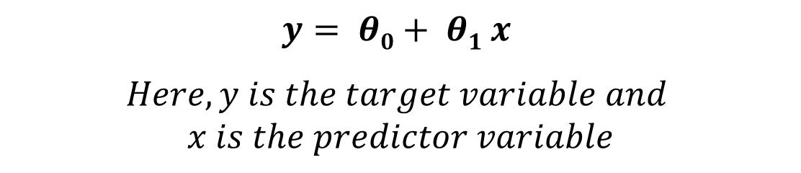
Simple Linear Regression : Intuition
Weight
There is only one predictor/input variable (Height) and one target variable (Weight) and we are intending to find out a relationship of the form:
w
h
Height
This is called Simple Linear Regression, because it has only one predictor variable and the relationship among target and predictor variable is linear.

Slide 5
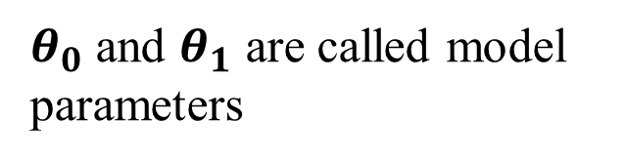
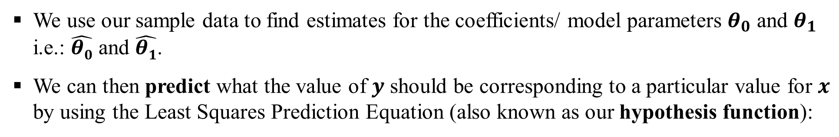
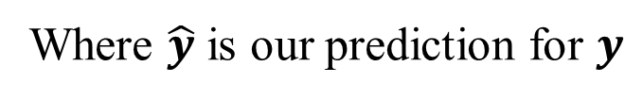
Simple Linear Regression : Hypothesis
Simple Linear Regression Model with Single Predictor
Target Variable
Intercept
Slope
Predictor Variable
Random Residual Error

Slide 6
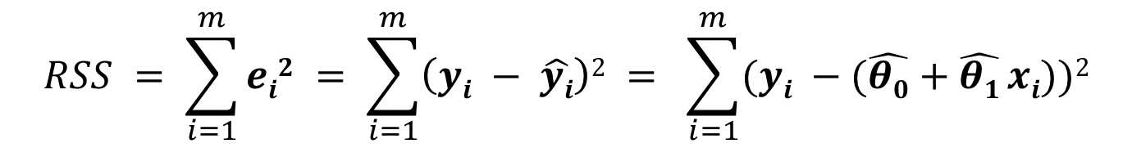







Simple Linear Regression : Cost Function
Residuals and Residual Sum of Squares:
$$y$$
We define Residual Sum of Squares (RSS) as:
$$y_{i}$$
$$e_{i}$$
$$\hat{y_{i}}$$
$$x_{i}$$
$$x$$

Slide 7
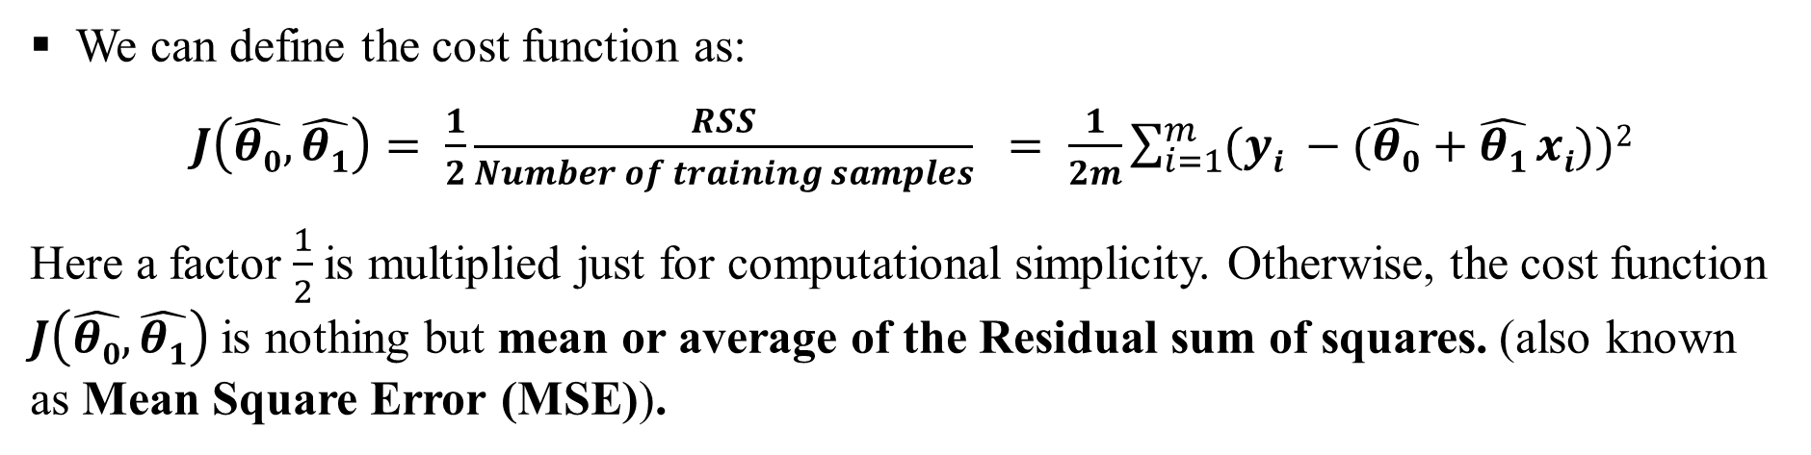
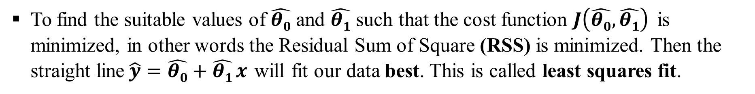
Simple Linear Regression : Cost Function
Mean Square Error Cost Function:
Our Objective:

Slide 8


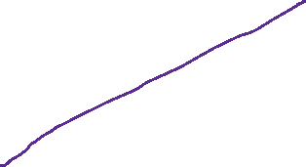
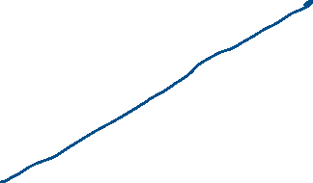
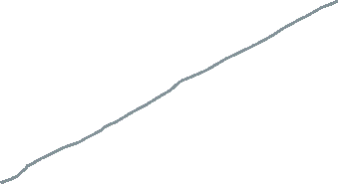
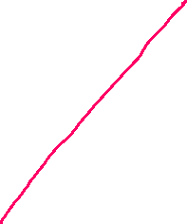
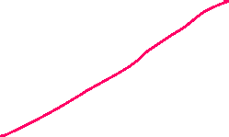
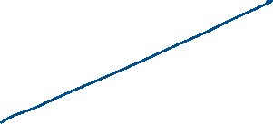
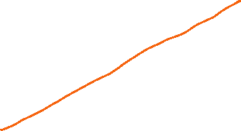

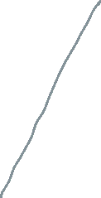

Slide 9
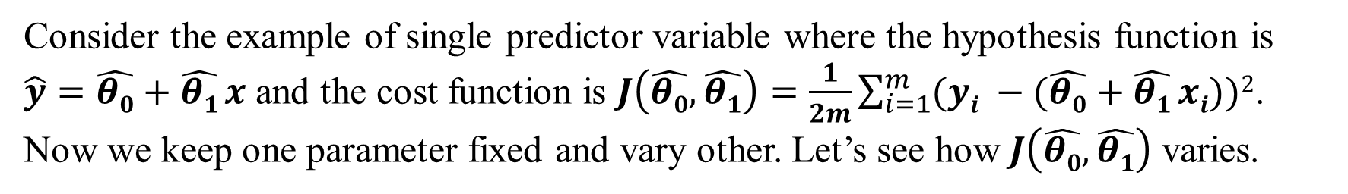






Simple Linear Regression : Cost Function
Intuition of Cost Function:
y
x
Our objective is to find the values of the parameters for which the cost function is minimized.

Slide 10
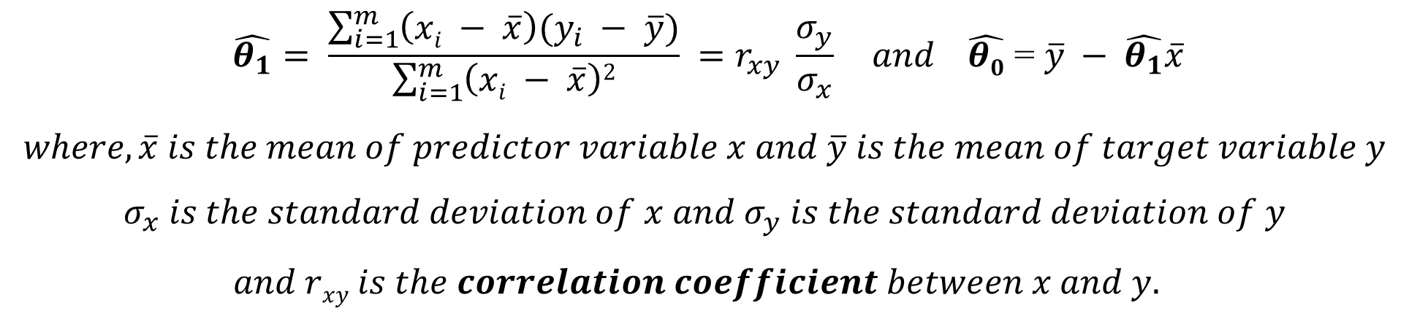
Simple Linear Regression : OLS fit
Solving for the best ﬁt: Ordinary Least Squares (OLS) Regression:
Hence we have to do, $\frac{∂}{∂\hat{θ_{0}}}\left(RSS\right)=0$and $\frac{∂}{∂\hat{θ_{1}}}\left(RSS\right)=0$

Slide 11






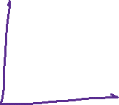








Slide 12
















Slide 13
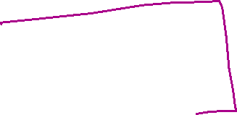


Slide 14
Thank You

